Slide 1

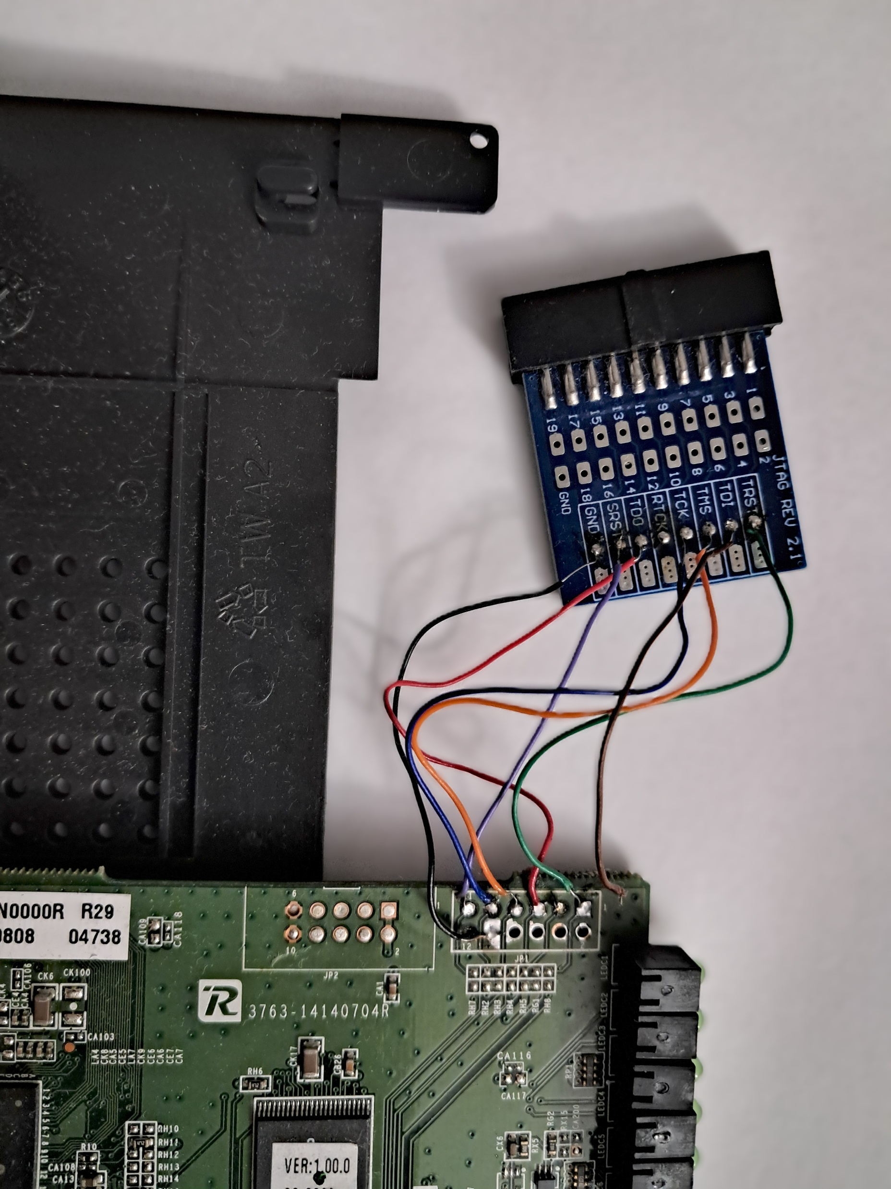
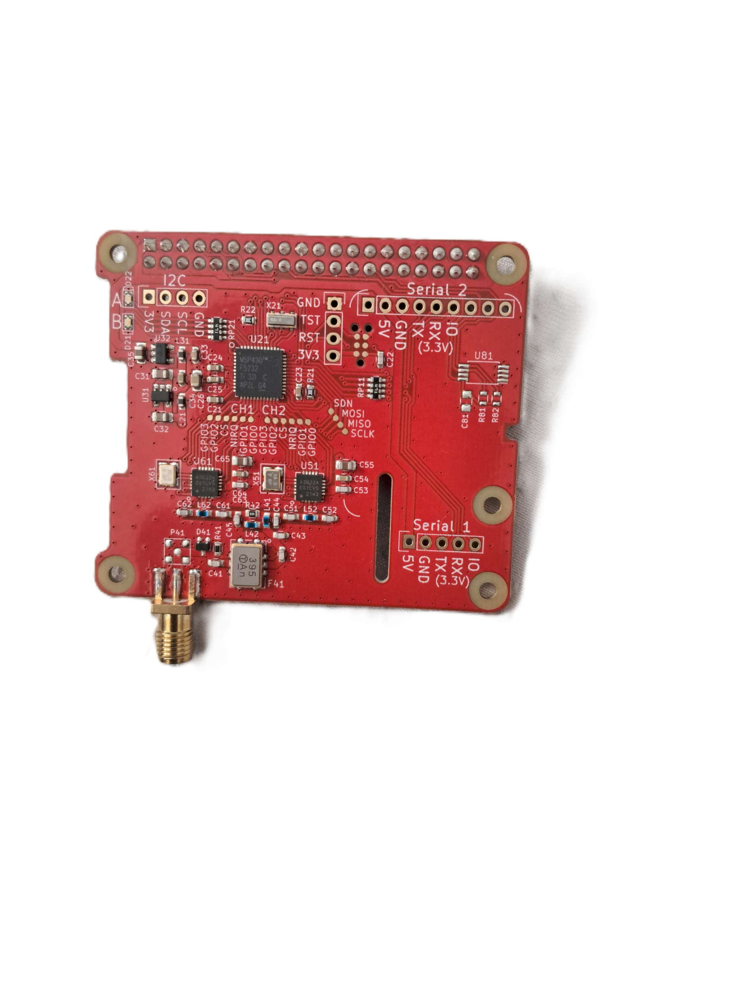
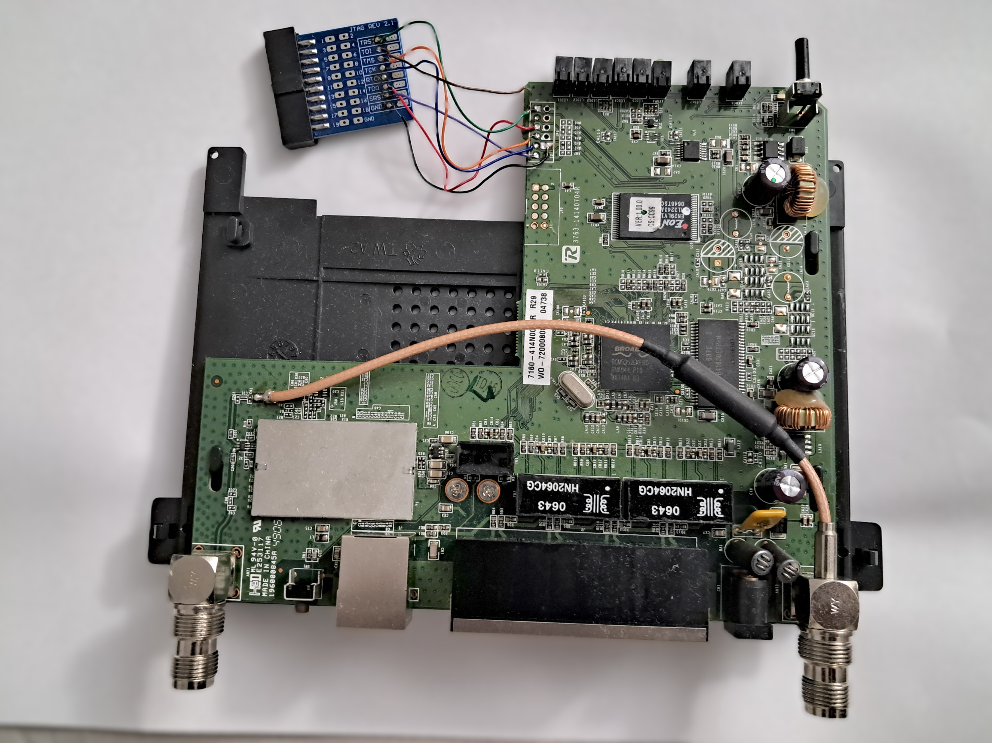
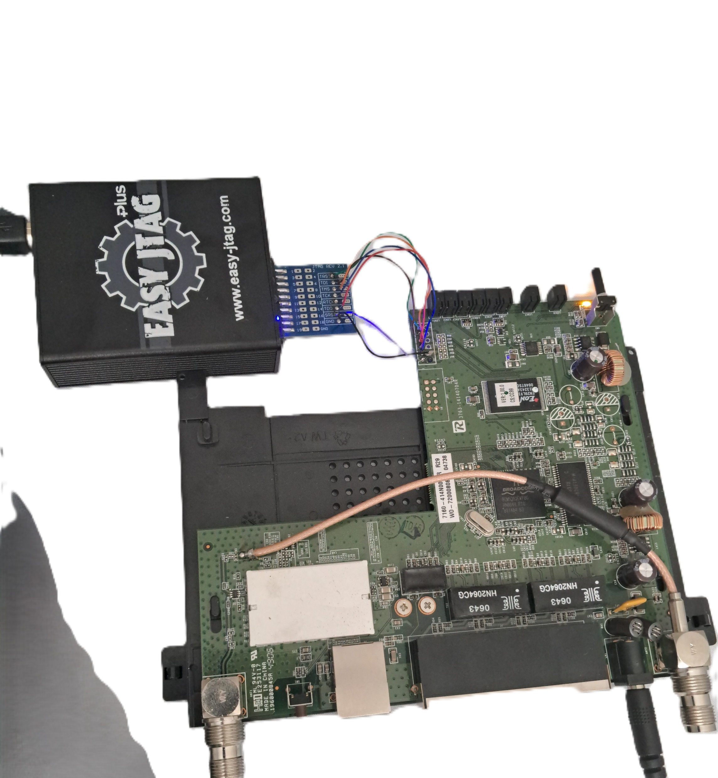
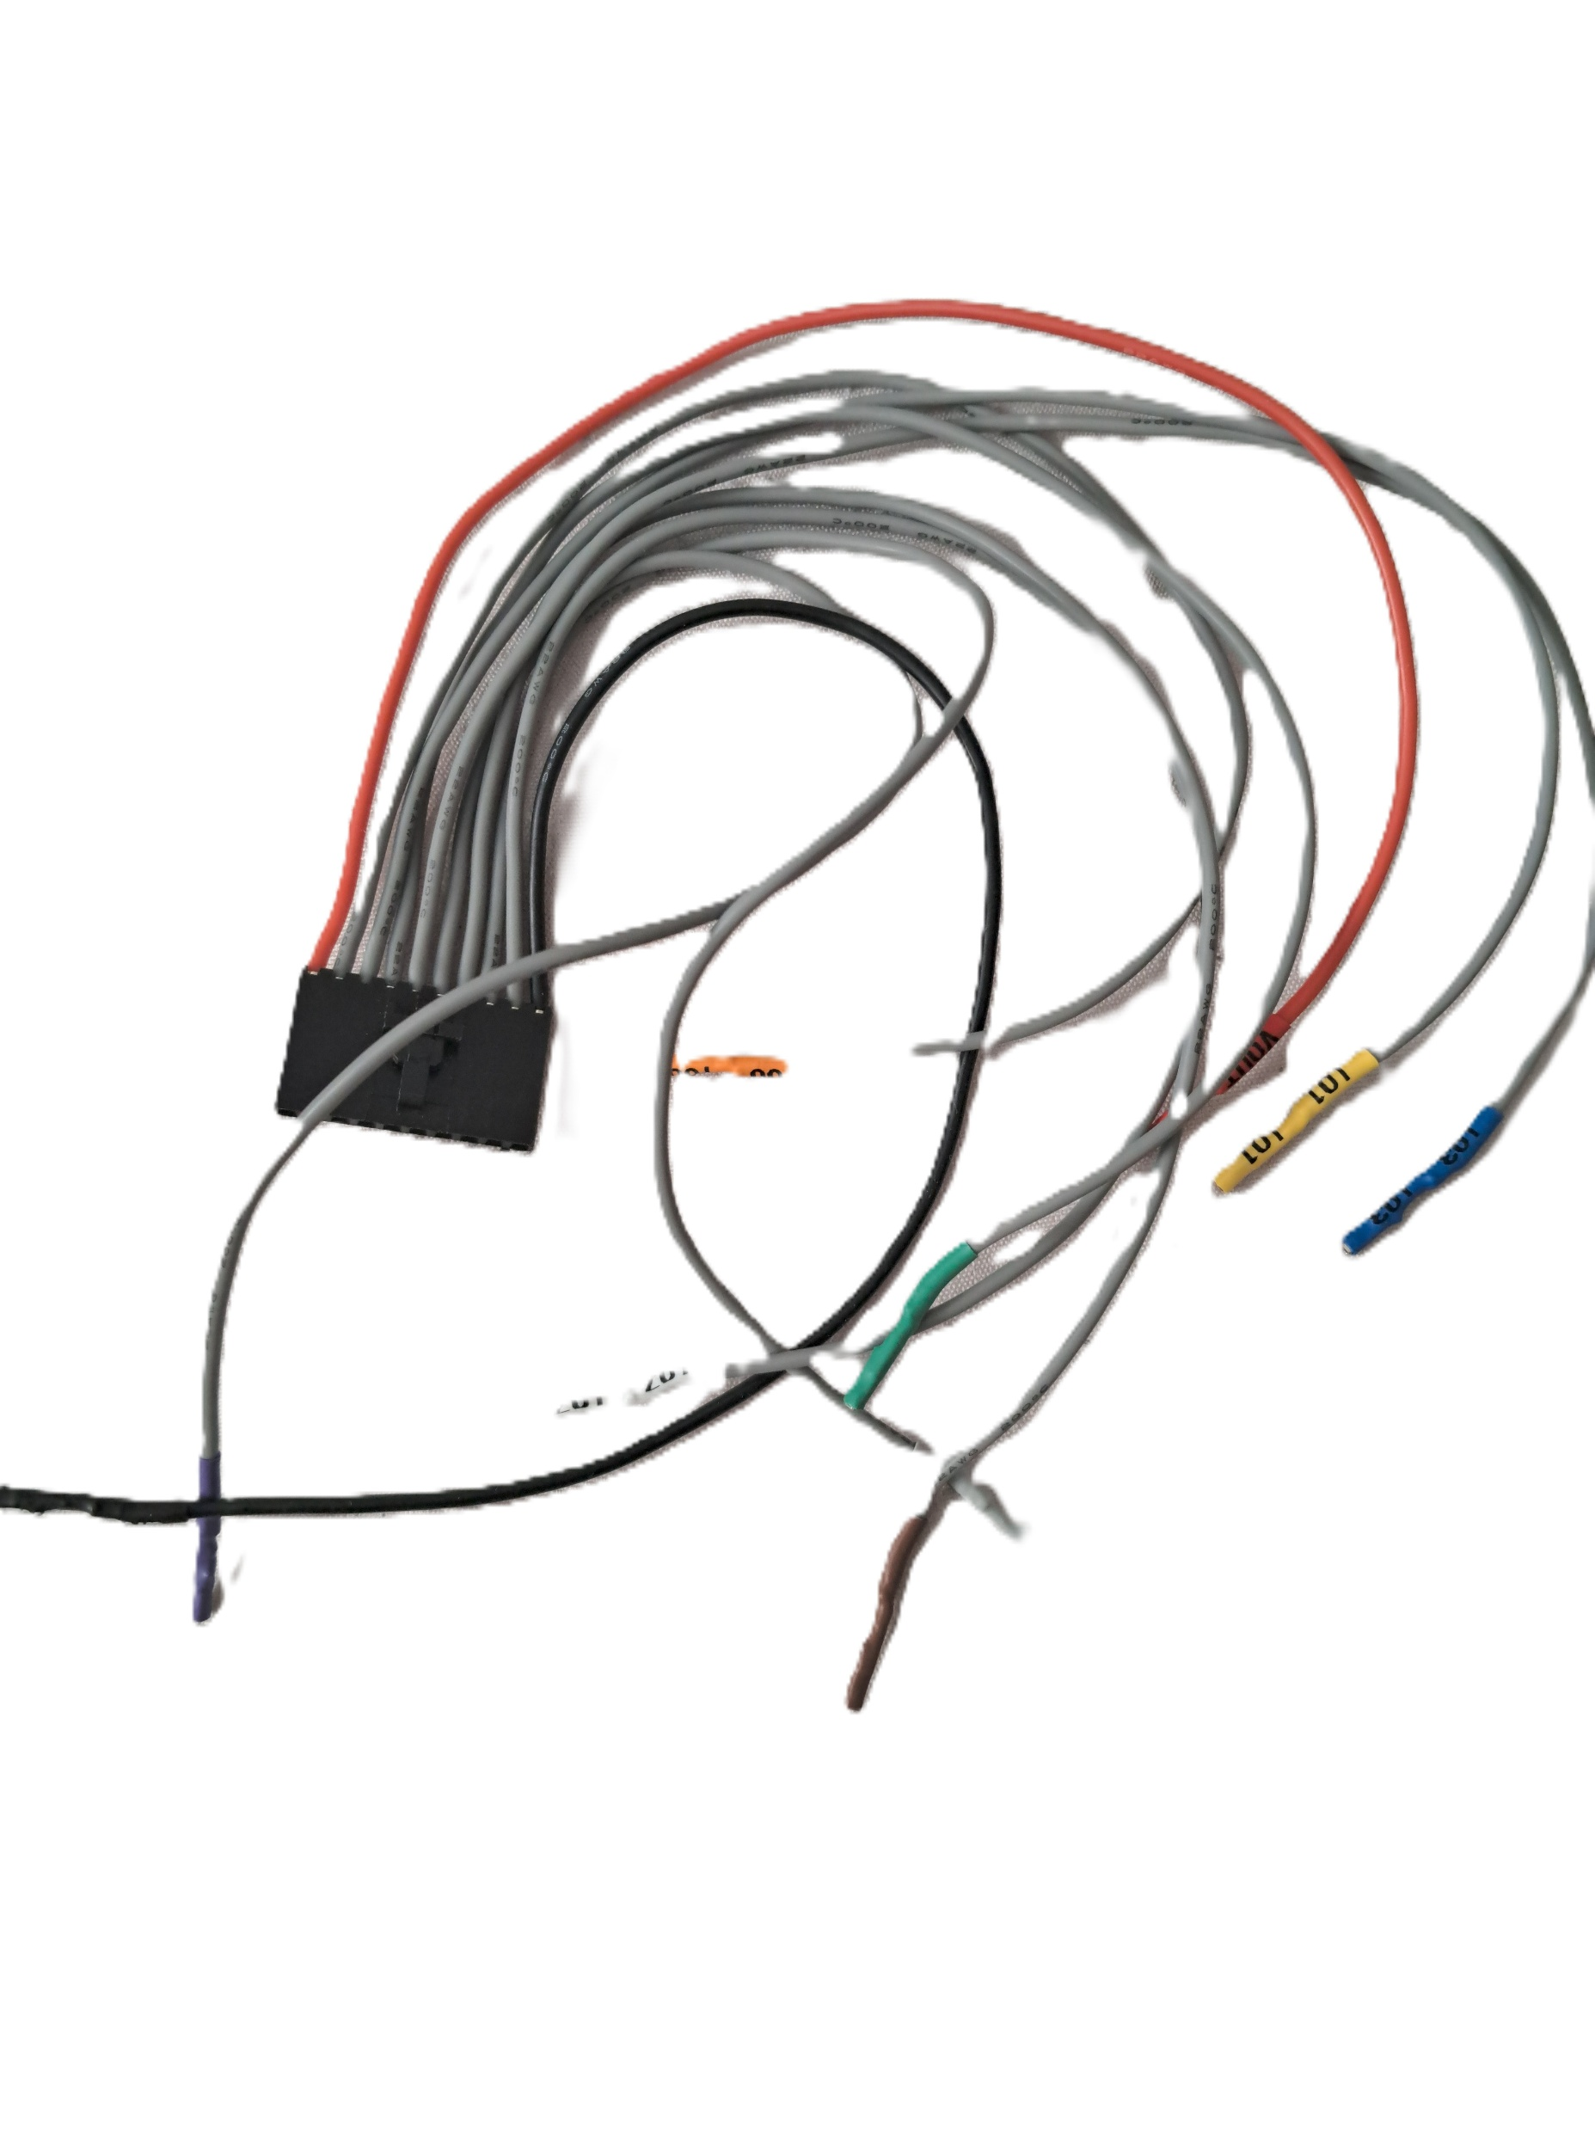
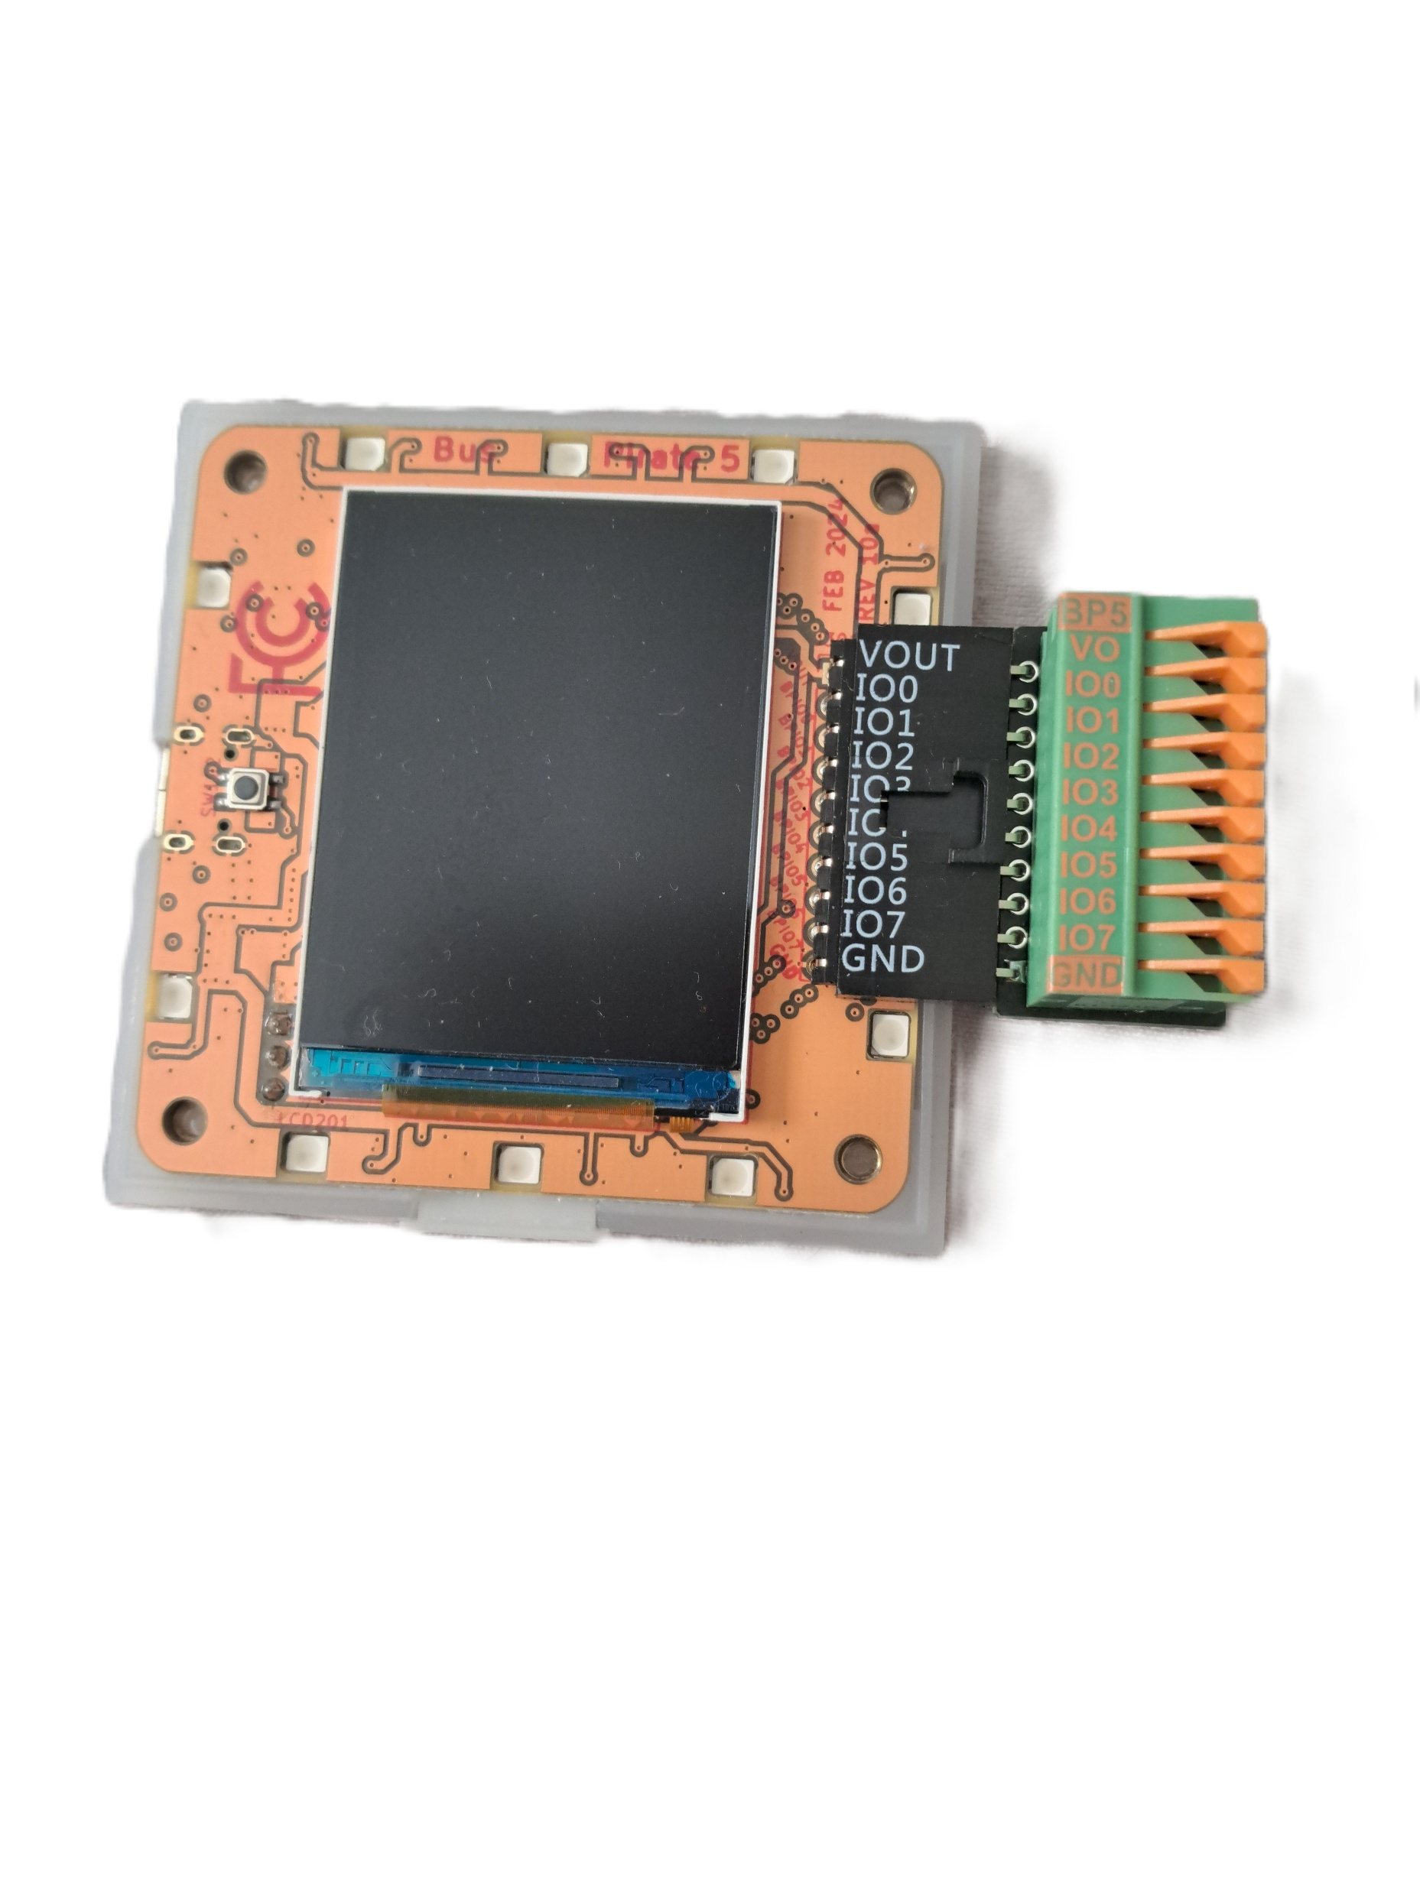

Firmware Extraction Using JTAG and UART
Prudhvi Raj Dasari
Department of Computer Science & Information Systems
University of North Carolina Wilmington
Abstract:
Embedded devices rely on firmware that controls boot, hardware drivers, and network services. Because firmware is stored in non-volatile memory and updated infrequently, vulnerabilities can persist long after deployment.
This project presents a practical, reproducible methodology to extract firmware using hardware debug interfaces (JTAG/UART) and—when JTAG is unavailable—an SPI fallback with Bus Pirate.
We document pin discovery, connection stability (SRST without TRST), safe dumping procedures, and integrity verification.
The workflow yields a raw binary image suitable for analysis and lays groundwork for auditing embedded device security.
Problem.& Objectives
Many embedded devices ship with outdated libraries, hardcoded credentials, and infrequent security updates. Debug interfaces are often undocumented, leaving vulnerabilities hidden for years.
Research Objectives:
Identify and verify JTAG/UART pins on the target device
Extract a complete flash image (.bin) and validate integrity (checksum)
Document a stable configuration (low JTAG speed, SRST init)
Provide an SPI fallback using Bus Pirate + flashrom
Outline security checks (default creds, exposed services, outdated components)
Results
Extraction outcome.: Stable connection using SRST, successful CPU detection, and complete dump (2 MB). Two consecutive reads produced matching SHA-256 checksums, confirming integrity.
Quick triage of image.: strings/hexdump revealed configuration and init scripts; evidence of legacy services (e.g., telnet) and older crypto libs (version checks pending). The binary is now ready for deeper, tool-based auditing (Binwalk/Ghidra) or emulation (QEMU) as future work.
System & Tools
Hardware. Multimeter (continuity pin mapping), Easy JTAG Plus (primary), Bus Pirate v5 (SPI fallback), soldering tools & jumpers.
Software. Easy JTAG Tool (read/handshake), Linux terminal (dd, cat, sha256sum), flashrom (Bus Pirate), basic inspection (strings, hexdump).
Output. Raw binary image (firmware.bin) — a byte-for-byte flash dump (not an .exe/.elf).
Methodology
Pinout verification continuity test → locate GND; trace & test TCK, TMS, TDI, TDO, SRST (TRST absent). Use SRST init in software.
JTAG configuration Set JTAG speed < 1000 kHz for stability; select SRST (ignore TRST). Confirm IDCODE/handshake in log.
Firmware dumping (JTAG route).:Read full flash: Start 0x00000000, Length 0x00200000 (2 MB). Verify with sha256sum.
SPI fallback (Bus Pirate).:Wiring (typ.): IO4→MOSI, IO5→MISO, IO3→CLK, IO2→CS, GND, (optional VOUT=3.3V when the board is unpowered).
Conclusions.
A repeatable hardware workflow for firmware extraction was demonstrated.
TRST is not mandatory; SRST with low JTAG speed ensured reliability.
The process yields a verified .bin image suitable for security analysis.
References:

